Slide 1

TEAM MEMBERS:
PRASANNA RAJ PAUL
BALA SUBRAHMANYAM
VIJAYA BHAVANI
RAJYA LAKSHMI
PRASANNA

Slide 2
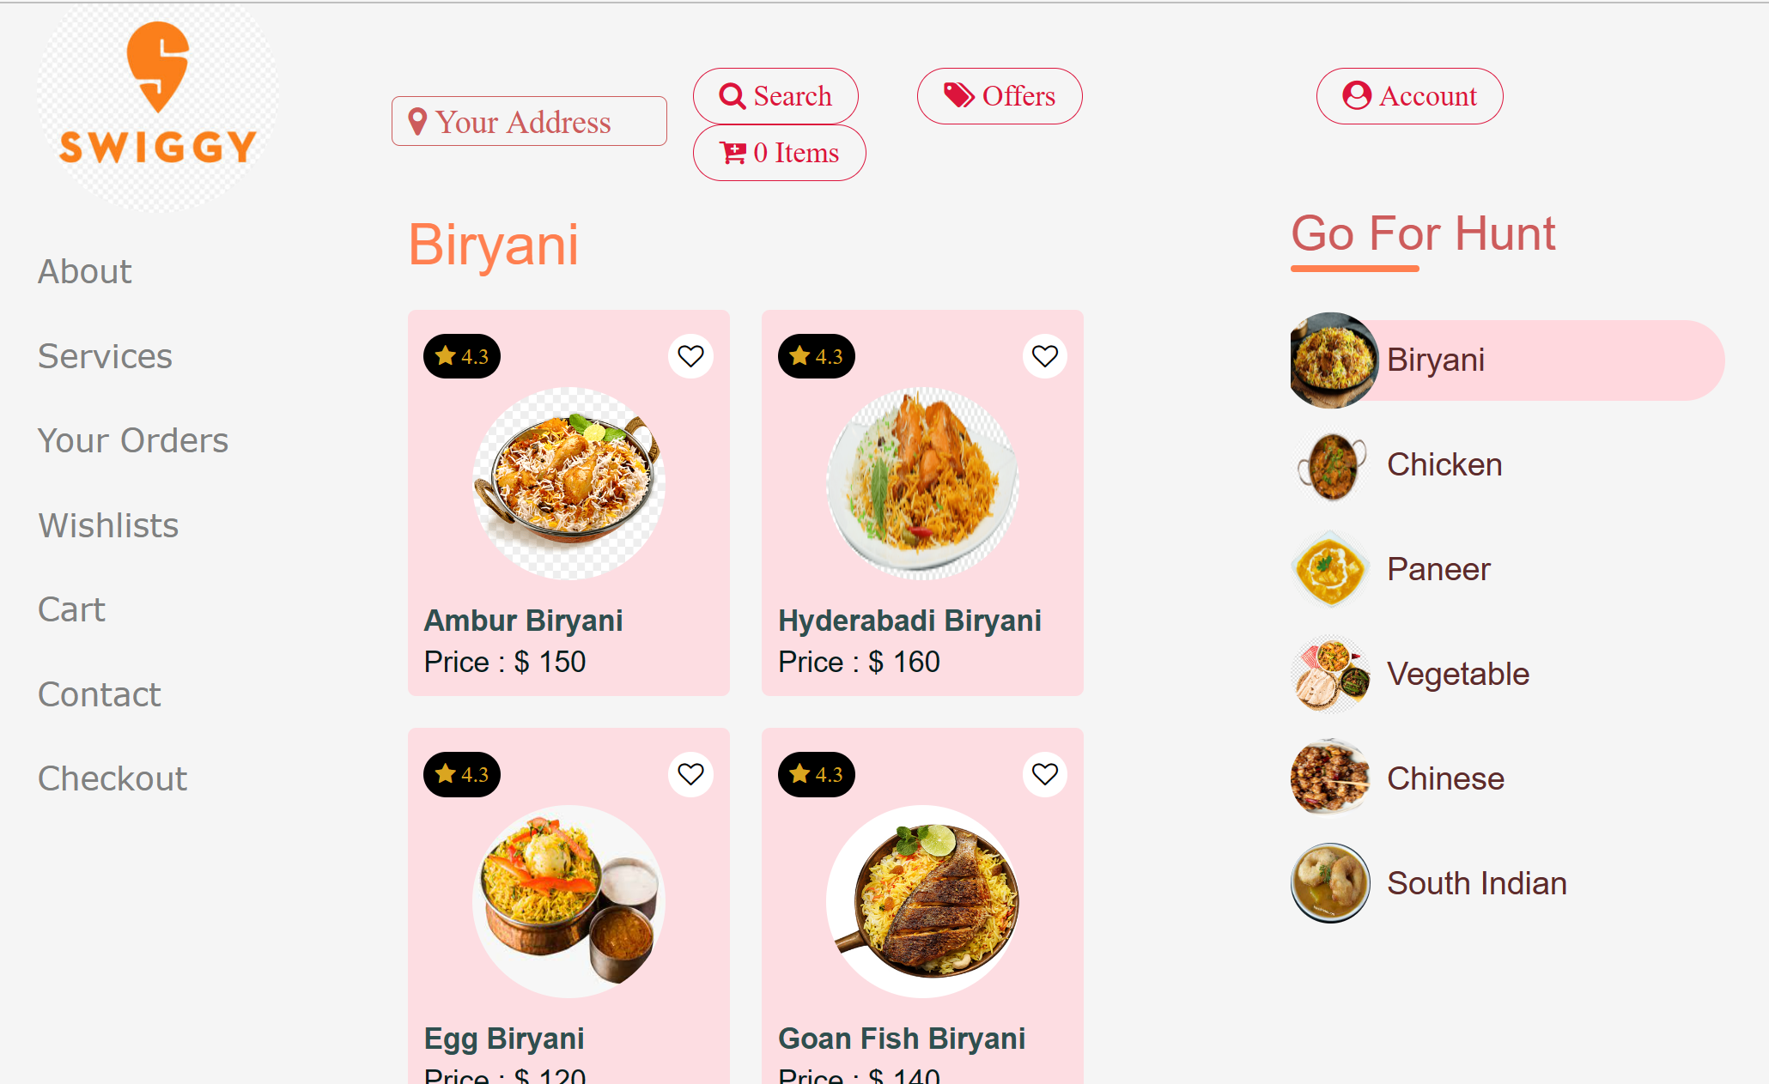
THIS IS OUR PROJECT HOME PAGE:

Slide 3
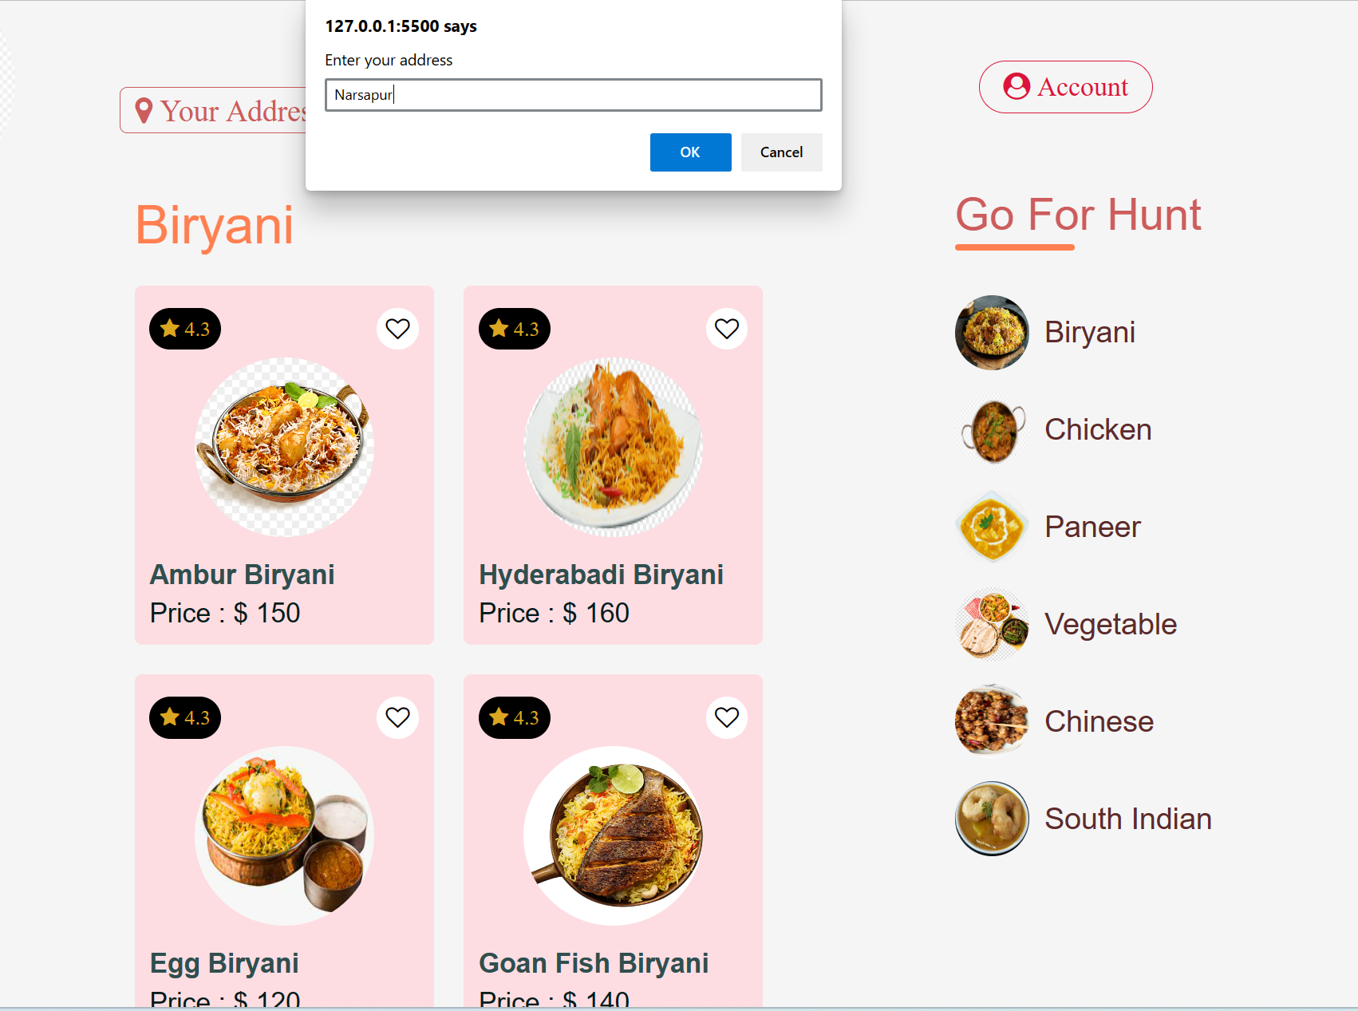
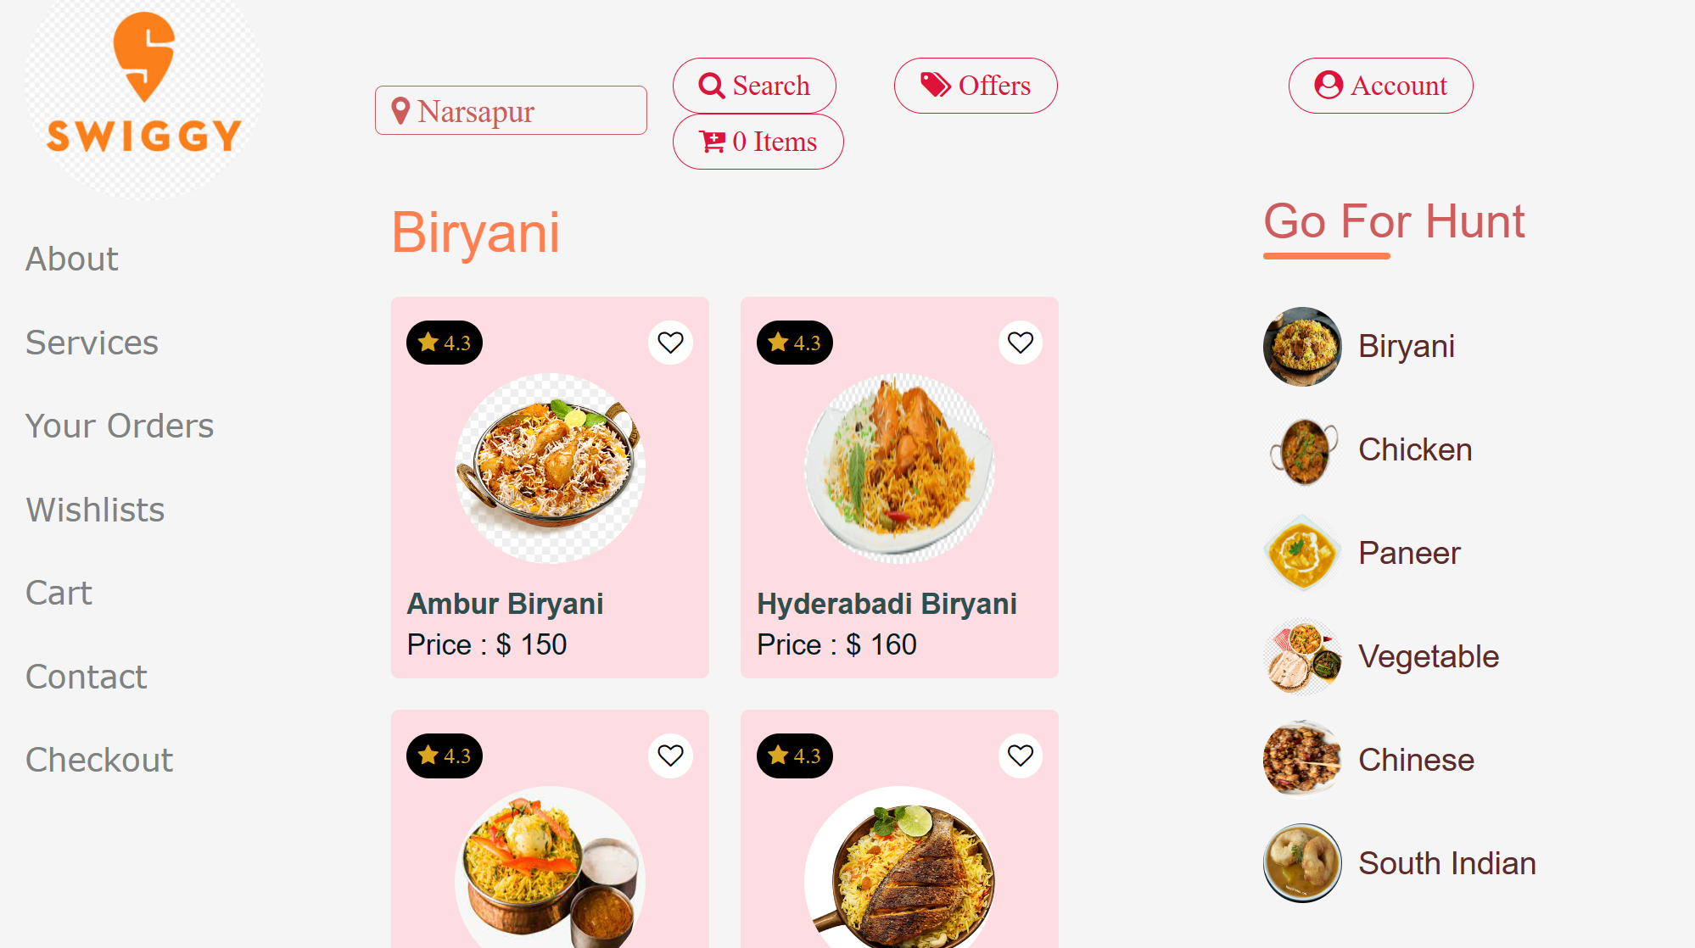
>Click on Your Address button in the home page ,it will ask to enter your Address >After typing the address ,the address will be displayed in the home page

Slide 4
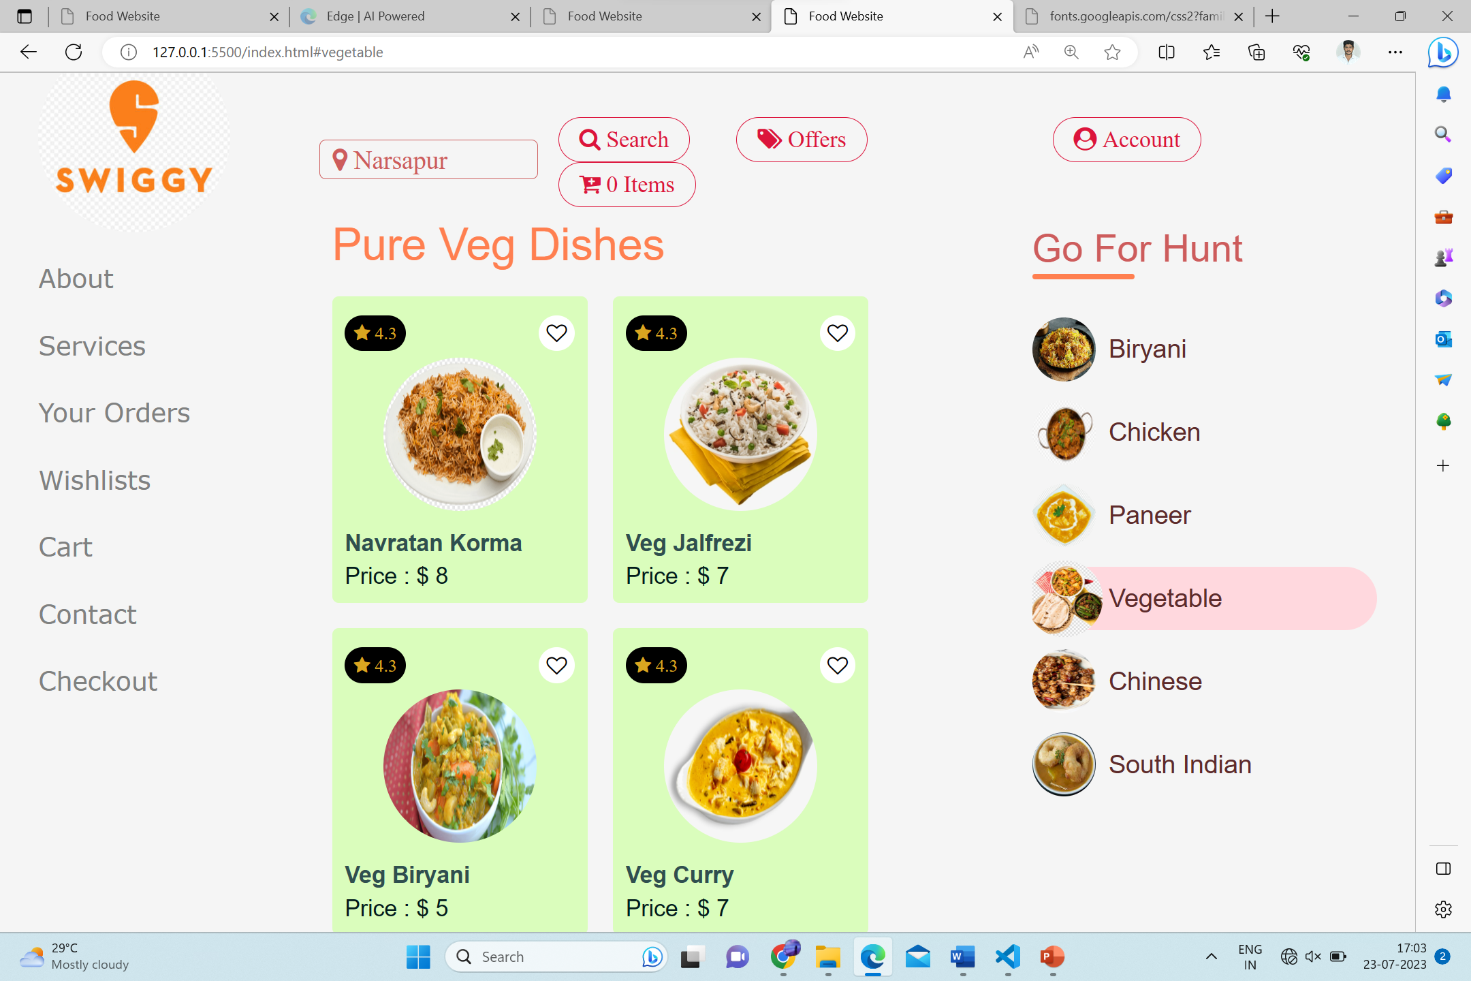
>In the left hand side you will see different types of items present in Go For Hunt. >You will select your interested item based on your preference, in the below figure we are selected vegetable. >It shows the what are all the sub items present in the vegetable with a display content of pure veg dishes.

Slide 5
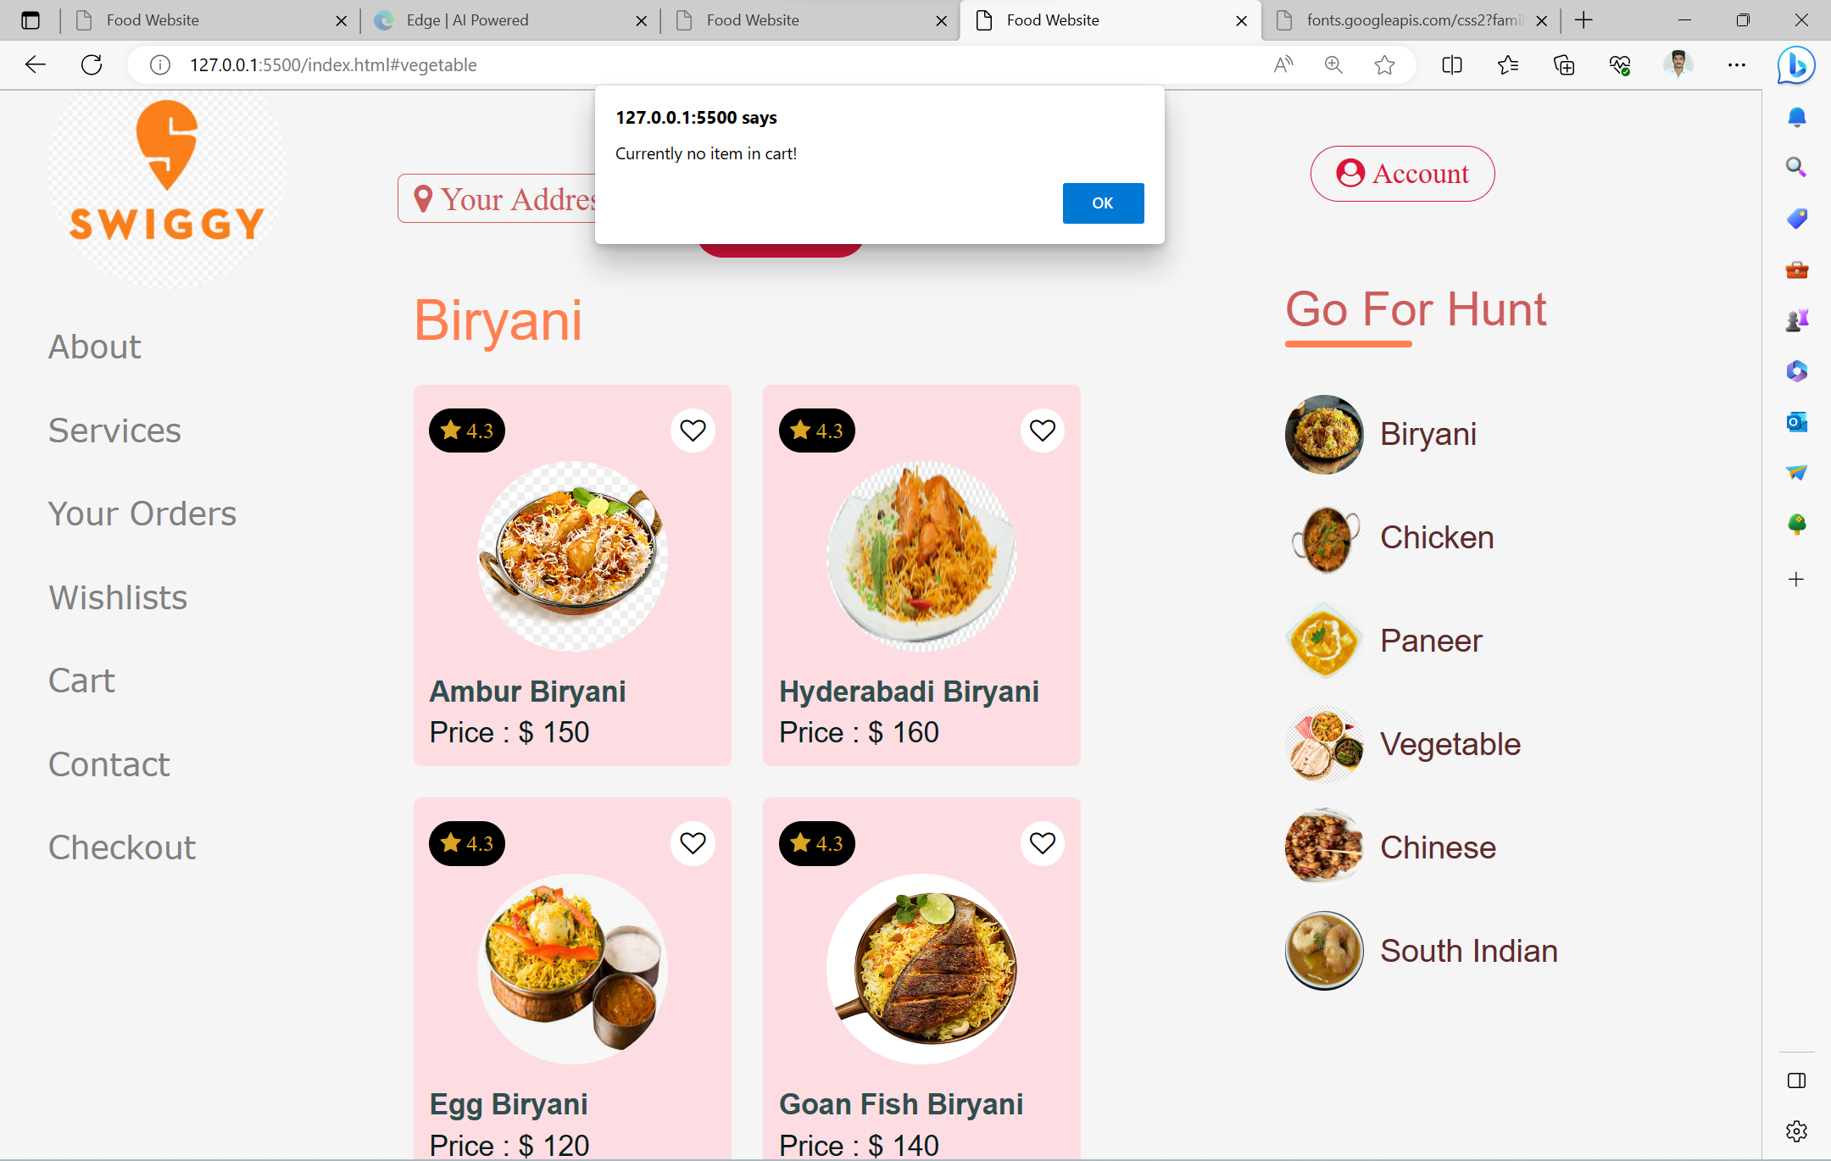
>If you want to click the cart ,it shows an alert message i.e., Currently no item in cart!

Slide 6
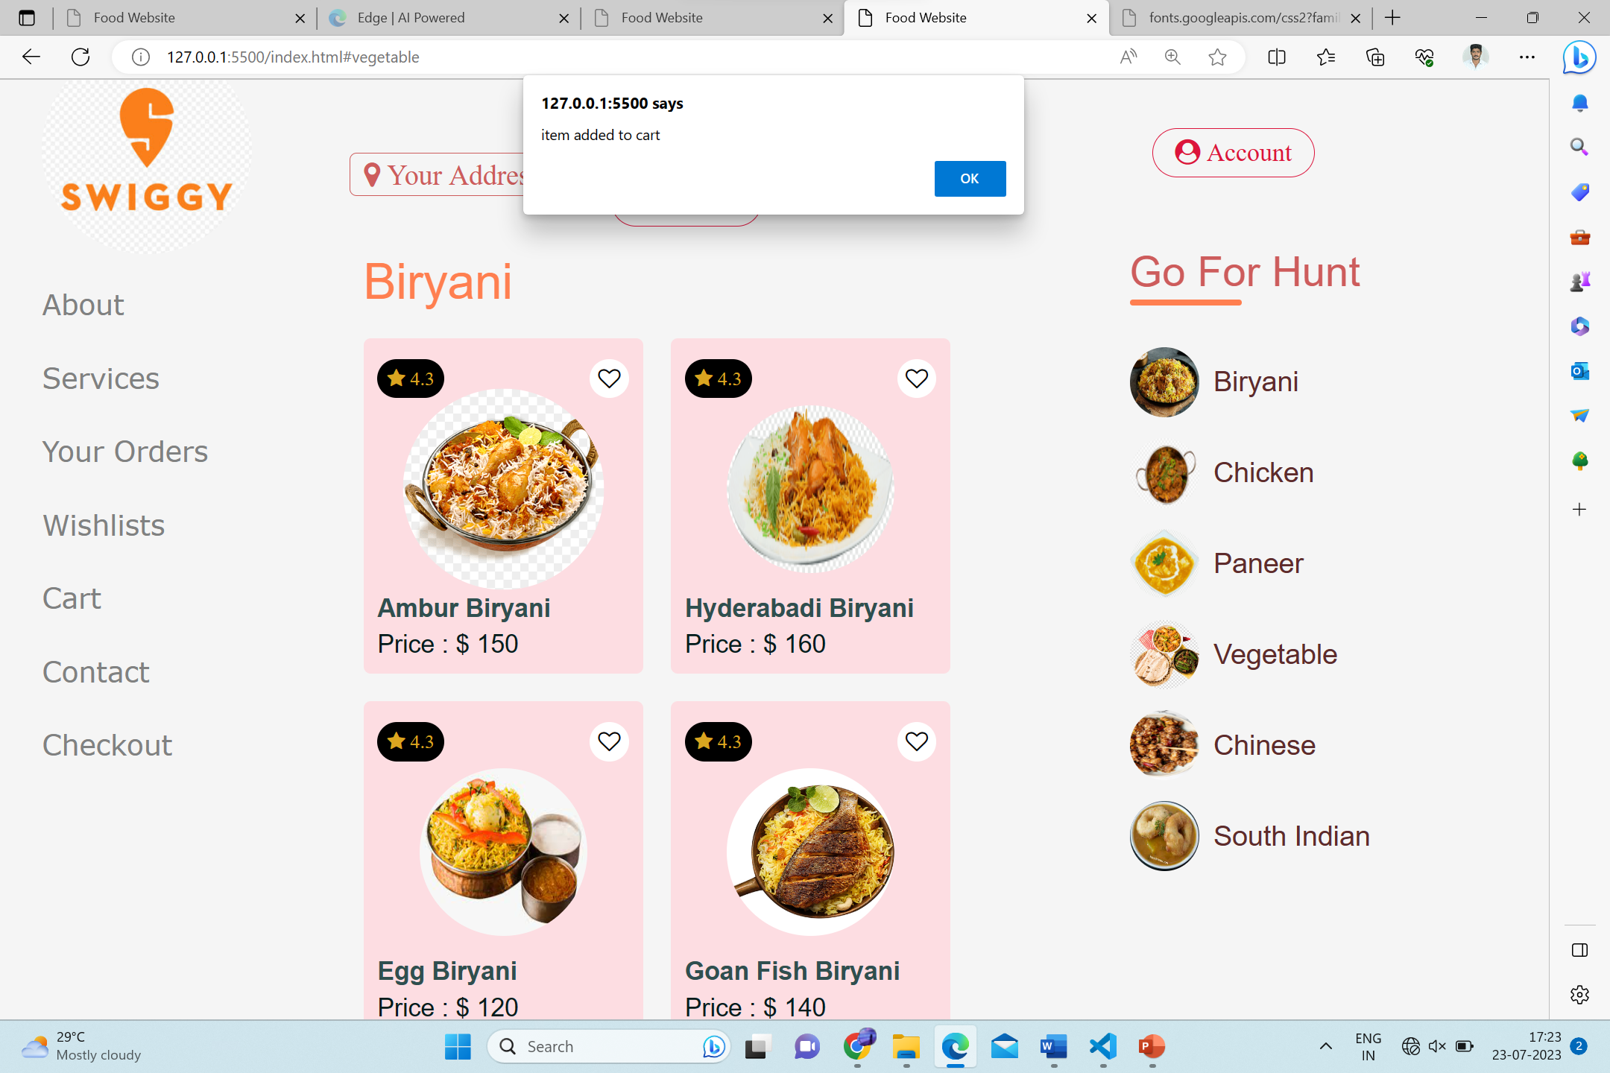
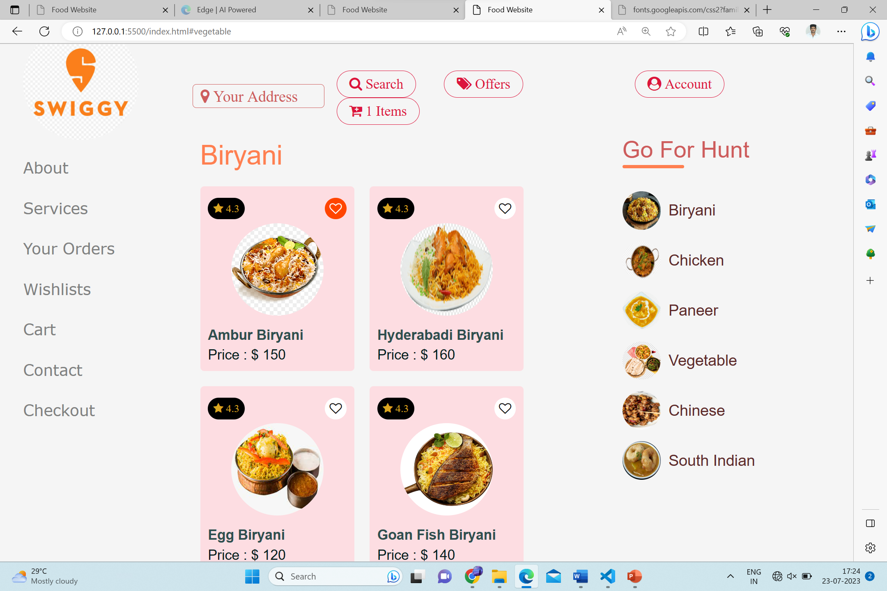
>If you want to click any heart symbol present on the top of the item card, it will shows an alert message like item added to cart. >After clicking ok ,the heart symbol is filled with an orange colour. >In the cart the no of items also displayed.

Slide 7
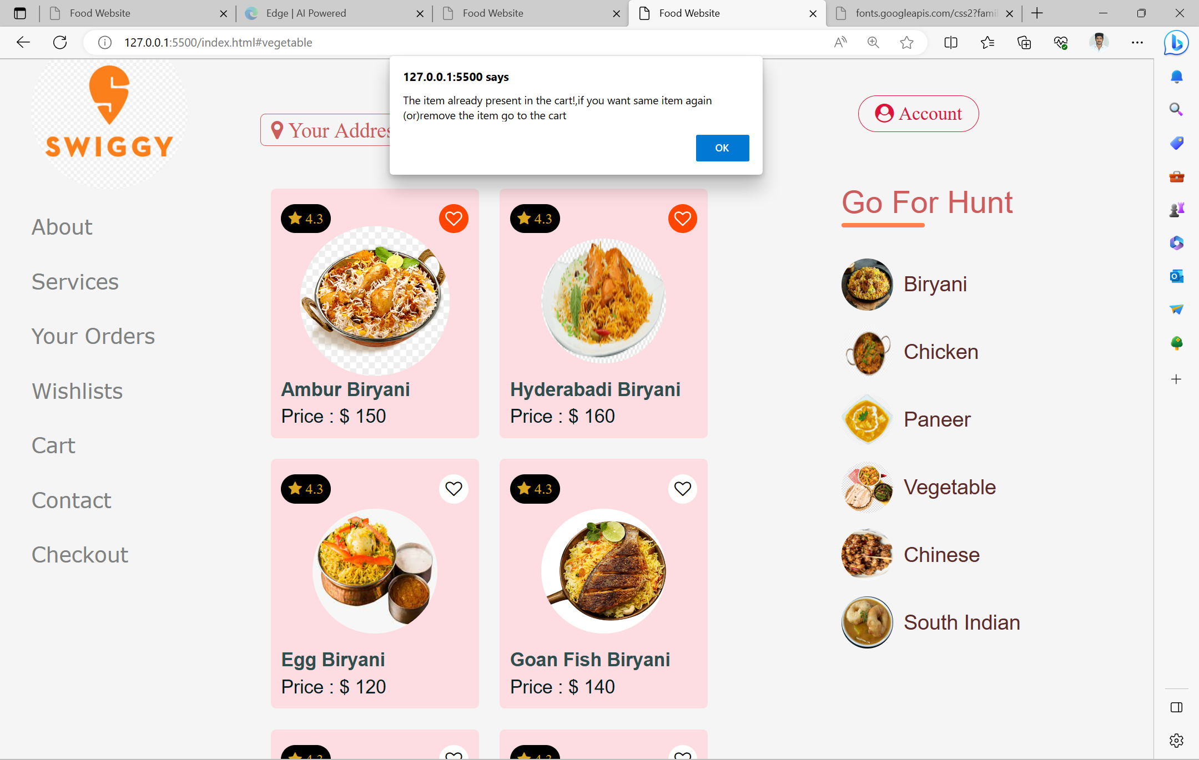
>You have to click on the same item ,it will show an alert message. i.e., The item already present in the cart. >You are all think like , why this alert message coming??.. >Because ,we have to give Quantity in the cart page , as per the users requirement the item Quantity can be increased or decreased .

Slide 8
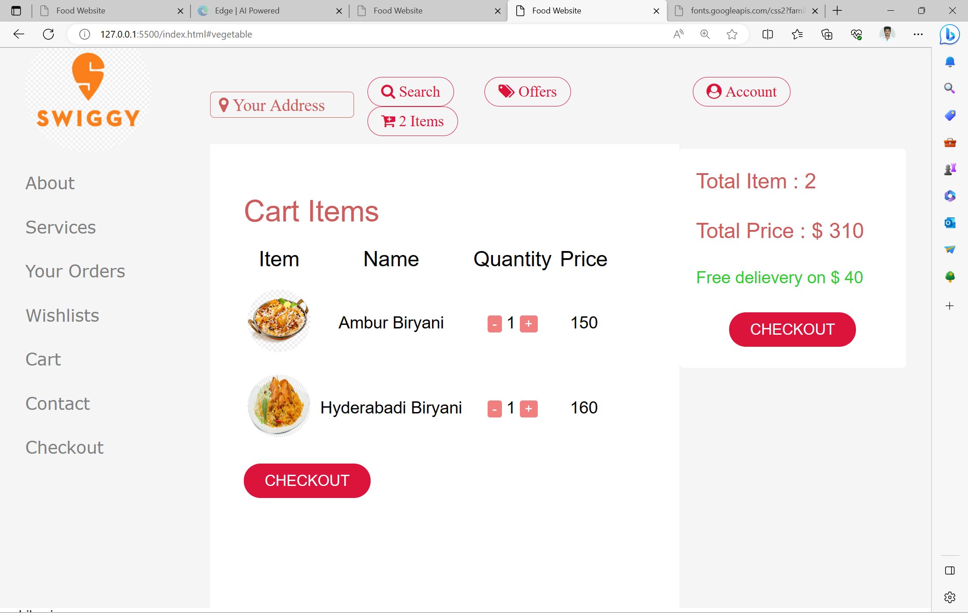

>This is our cart page , in this page it displays item image, name, quantity, price. >You have to increase the Quantity , the price also be increased and shows the total price , total items.

Slide 9
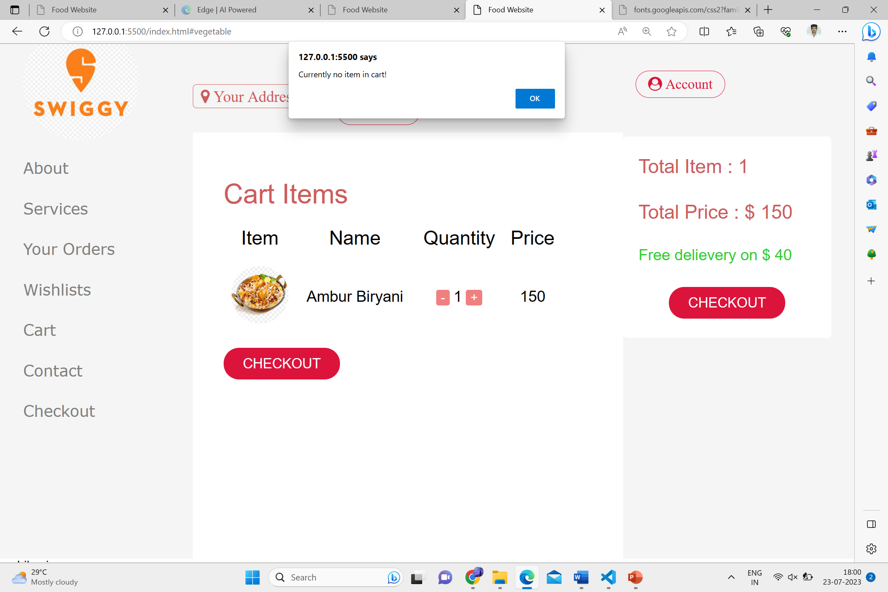
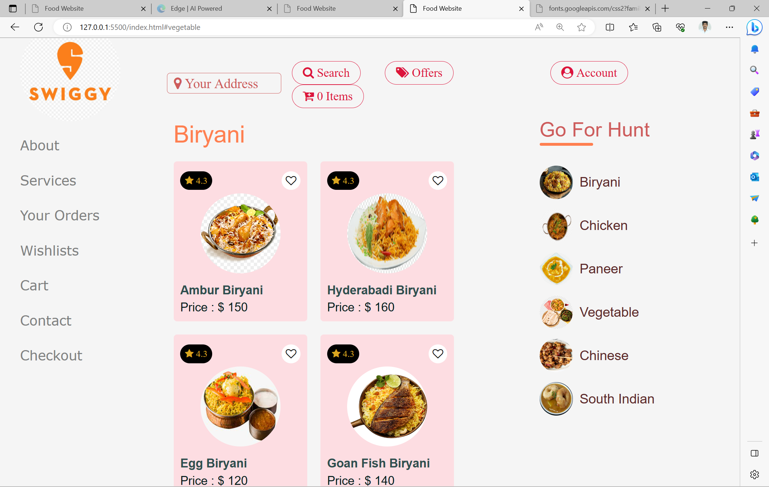
>If you want to remove all the items in the cart ,it will shows an alert message like currently no item in cart. >After clicking ok it comes to the Homepage , and shows zero items in the cart.

Slide 10
THANK
YOU
ALL

